Slide 1
Amstrong® Ultra The smartest choice
© AzriSuratmin, istockphoto.com, adapted by Philippe Vandenameele

Slide 2
Amstrong® Ultra Weight reduction of heavy vehicles
© Dragunov/Shutterstock.com

Slide 3
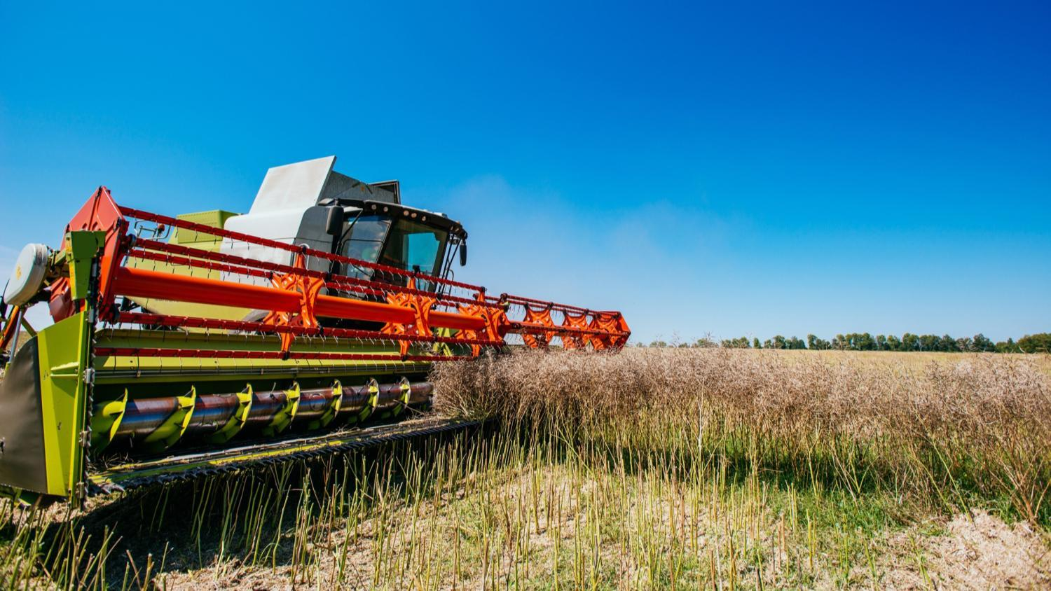
Amstrong® Ultra Increasing efficiency thanks to longer cutting heads
© Strandret/Shutterstock.com

Slide 4
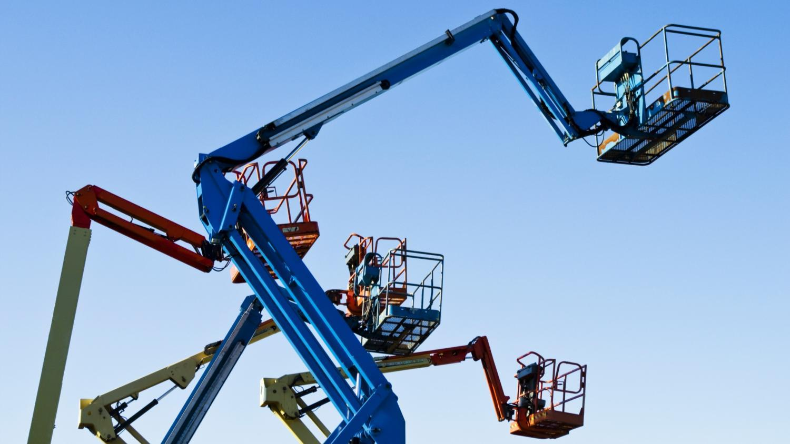
Amstrong® Ultra Most stringent toughness performance
© EastvanFran/Shutterstock.com

Slide 5
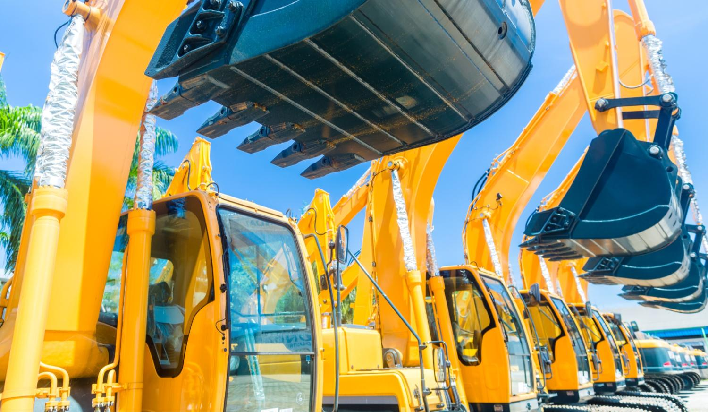
Amstrong® Ultra
Full product range from 650MPa to 1100 MPa
© Kzenon / shutterstock.com

Slide 6
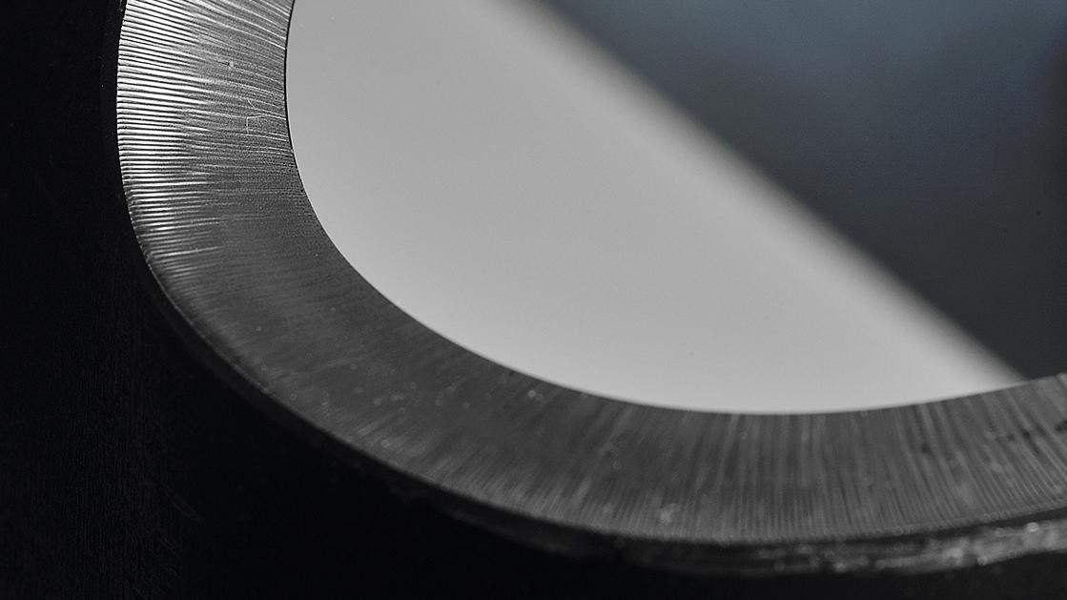
Amstrong® Ultra
Available as thermo-mechanically rolled/quenched & tempered products
© Jeroen Op de Beeck

Slide 7
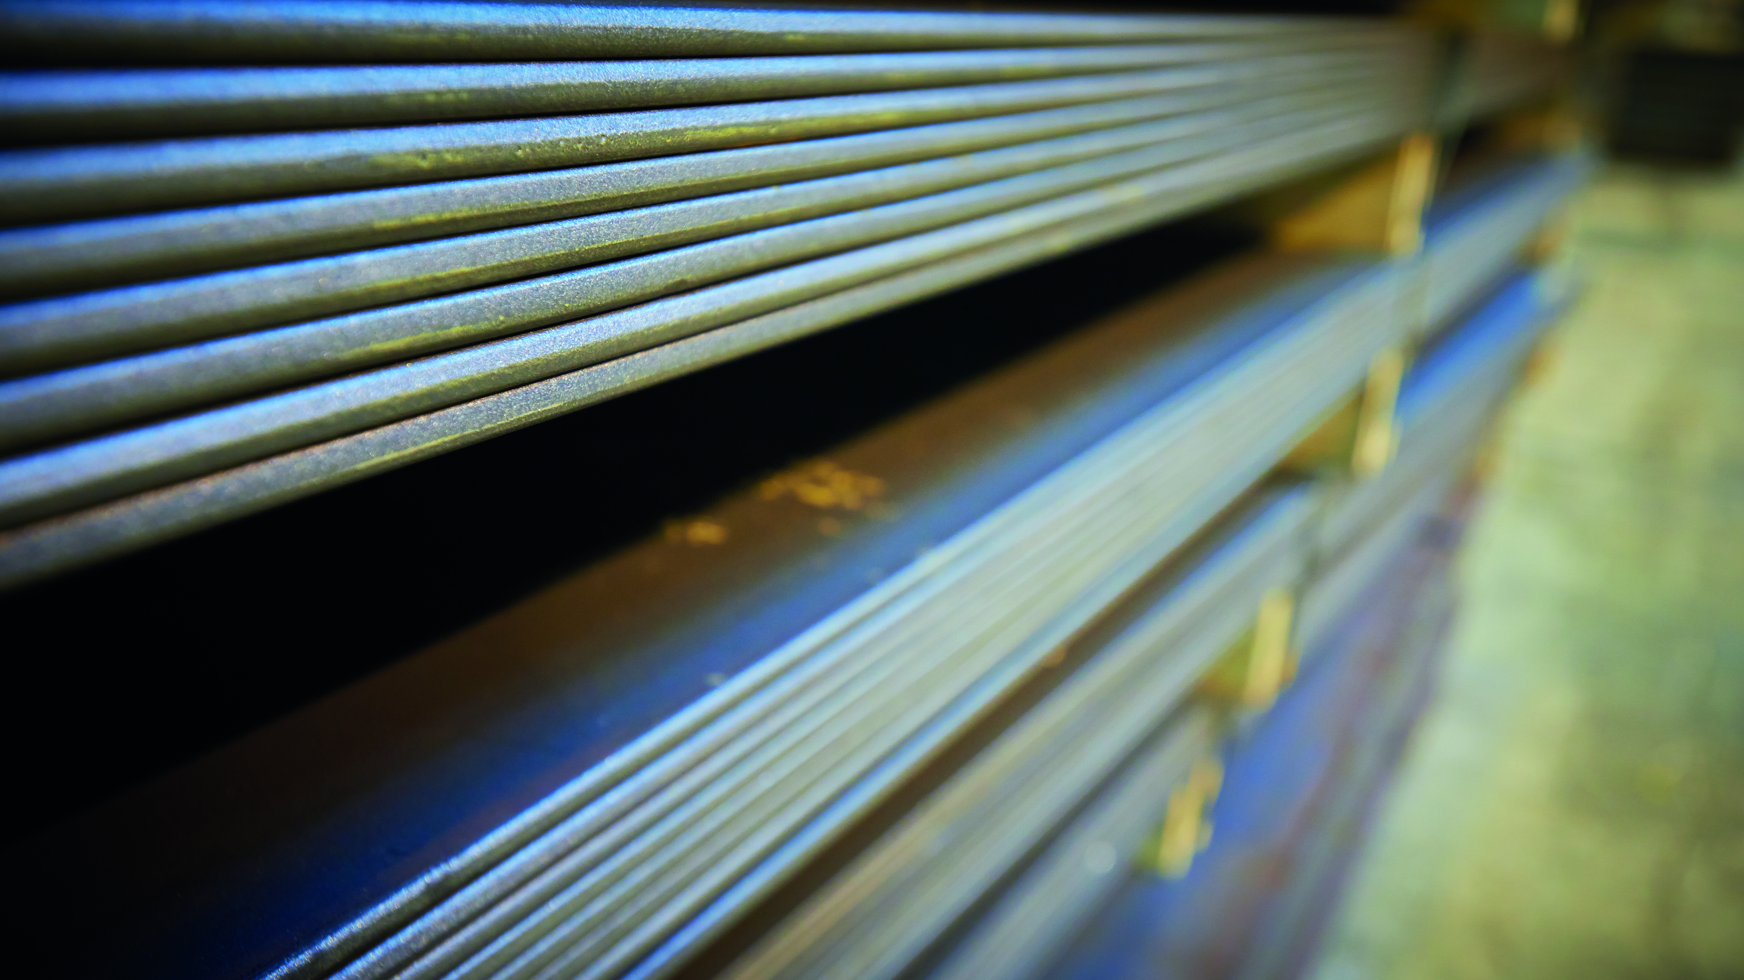
Amstrong® Ultra
Widest dimensional range on the market
© Industeel

Slide 8
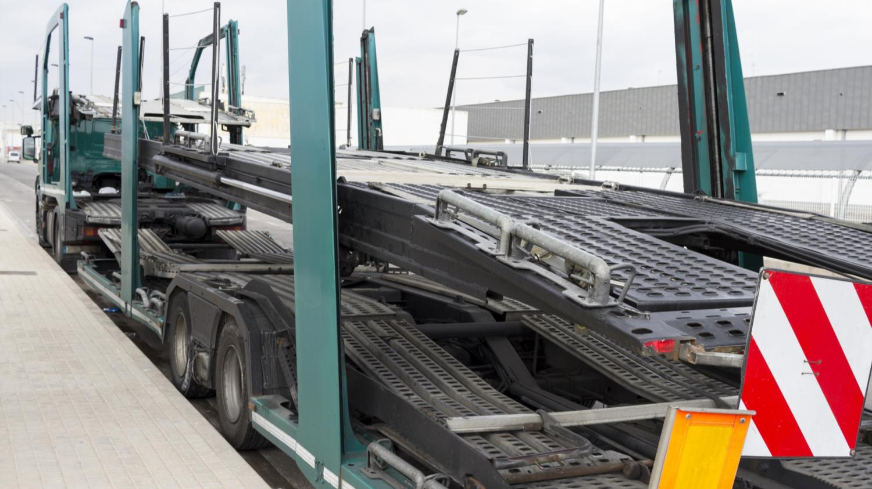
Amstrong® Ultra 40 % weight reduction compared with chassis in conventional structural steel
© Salva GC/Shutterstock.com

Slide 9
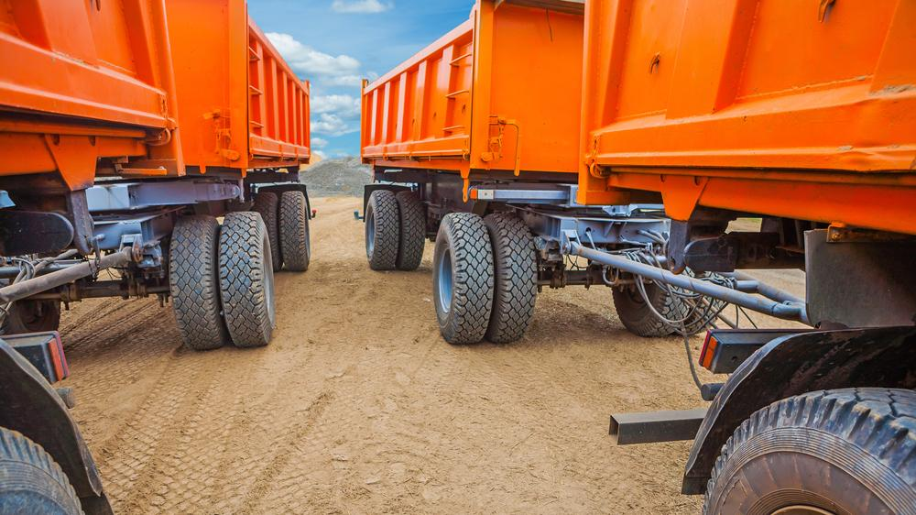
Amstrong® Ultra Enabling 30% reduction of manufacturing cost
© Mihalek/Shutterstock.com

Slide 10
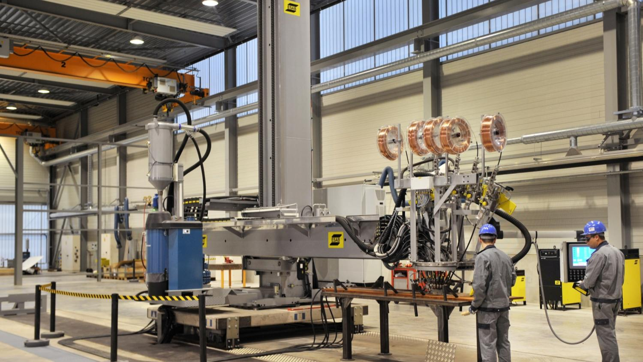
We offer full support to optimise design & manufacturing of lightweight long lasting components
© OCAS

Slide 11
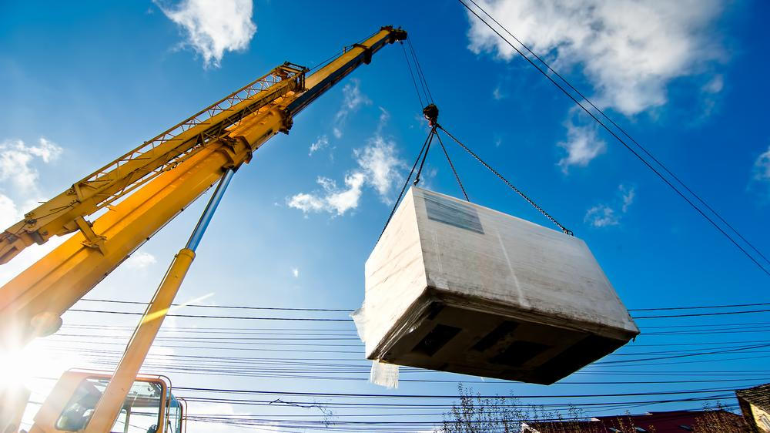
Amstrong® Ultra Lighter & longer crane booms with higher loading capacity
© Bogdanhoda/Shutterstock.com

Slide 12
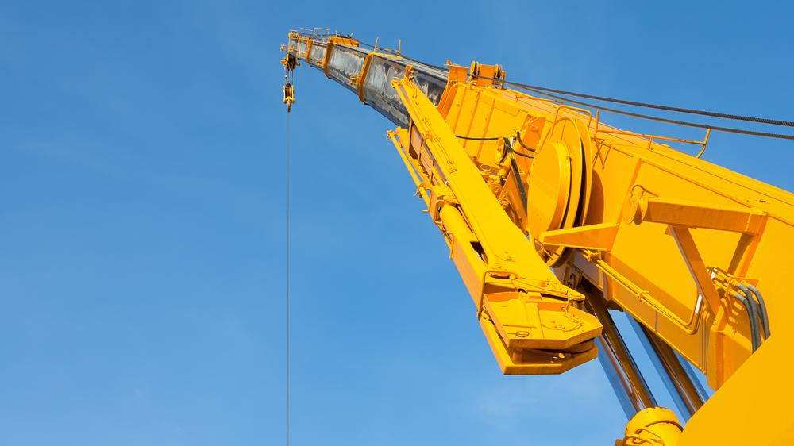
Amstrong® Ultra
Cranes more sturdy
© LovePHY/Shutterstock.com

Slide 13
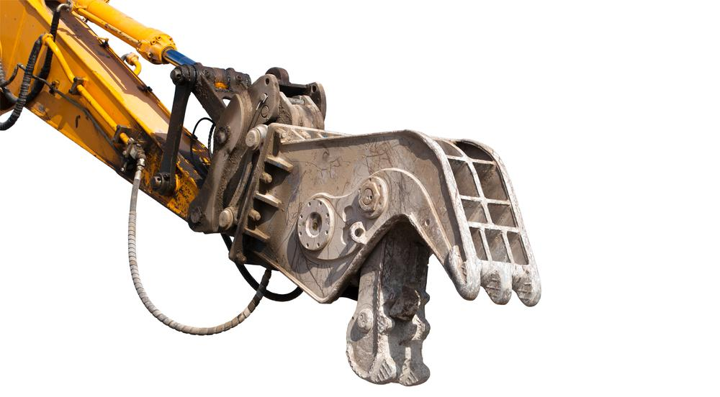
© Vadim Ratnikov / shutterstock.com
Amstrong® Ultra
Most stringent toughness performance

Slide 14
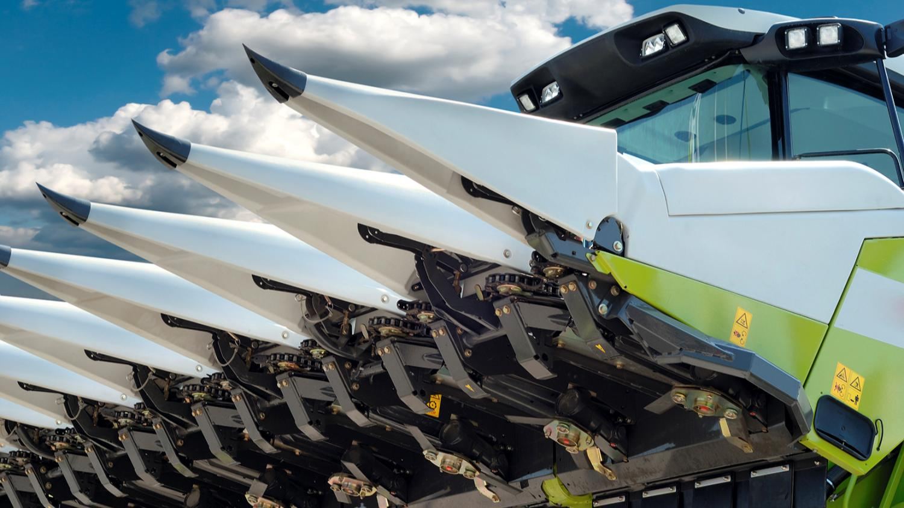
© Fotokostic / shutterstock.com
Amstrong® Ultra Enabling smarter design to improve performance

Slide 15
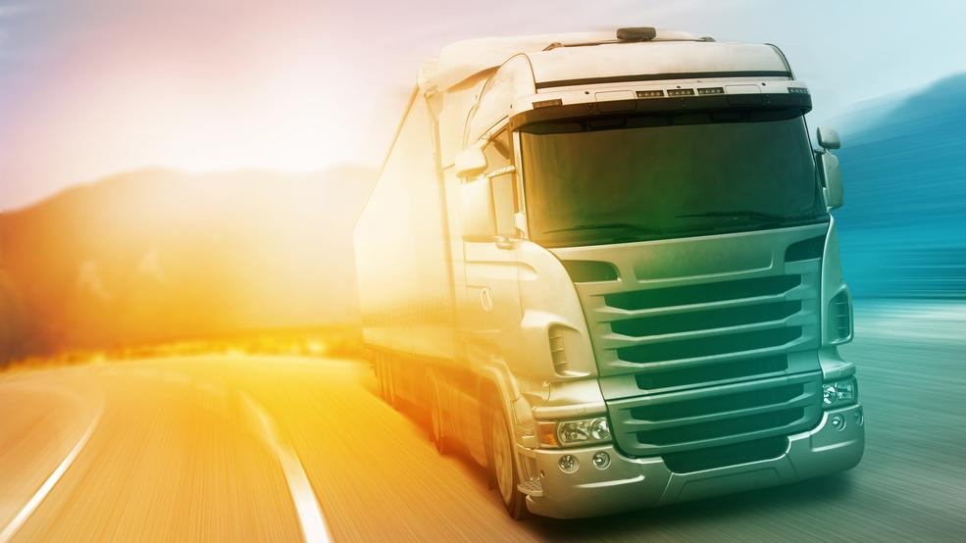
Amstrong® Ultra Lighter & greener transport solutions
© Nomad_Soul/Shutterstock.com

Slide 16
Amstrong® Ultra The smartest choice
© AzriSuratmin, istockphoto.com, adapted by Philippe Vandenameele

Slide 17
Produced by: ArcelorMittal Europe Communications
© 2016

