Slide 1
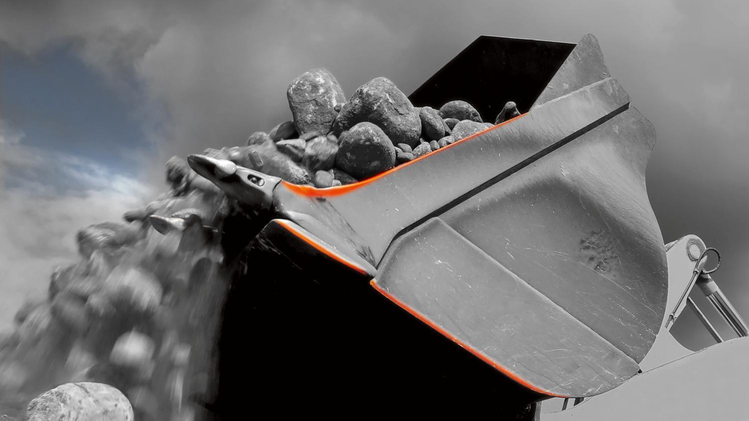
© Four Oaks, shutterstock.com, adapted by Philippe Vandenameele
Relia® Minimum wear, maximum payload

Slide 2
© Industeel
Relia® Increase payload & reduce fuel consumption

Slide 3
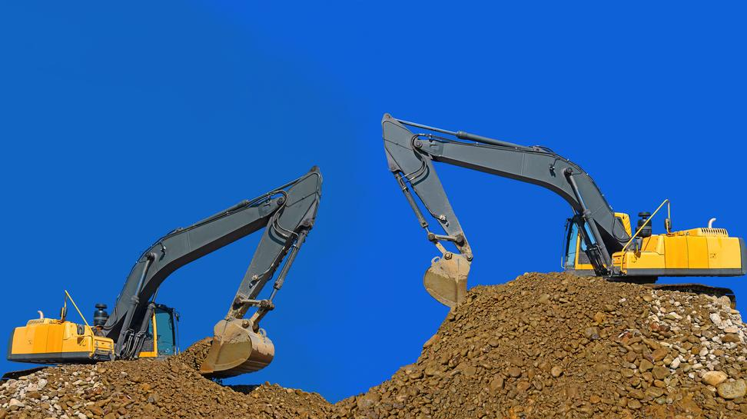
Relia® Wear resistance up to 3-6 times higher than conventional structural steel
© Smereka/Shutterstock.com

Slide 4
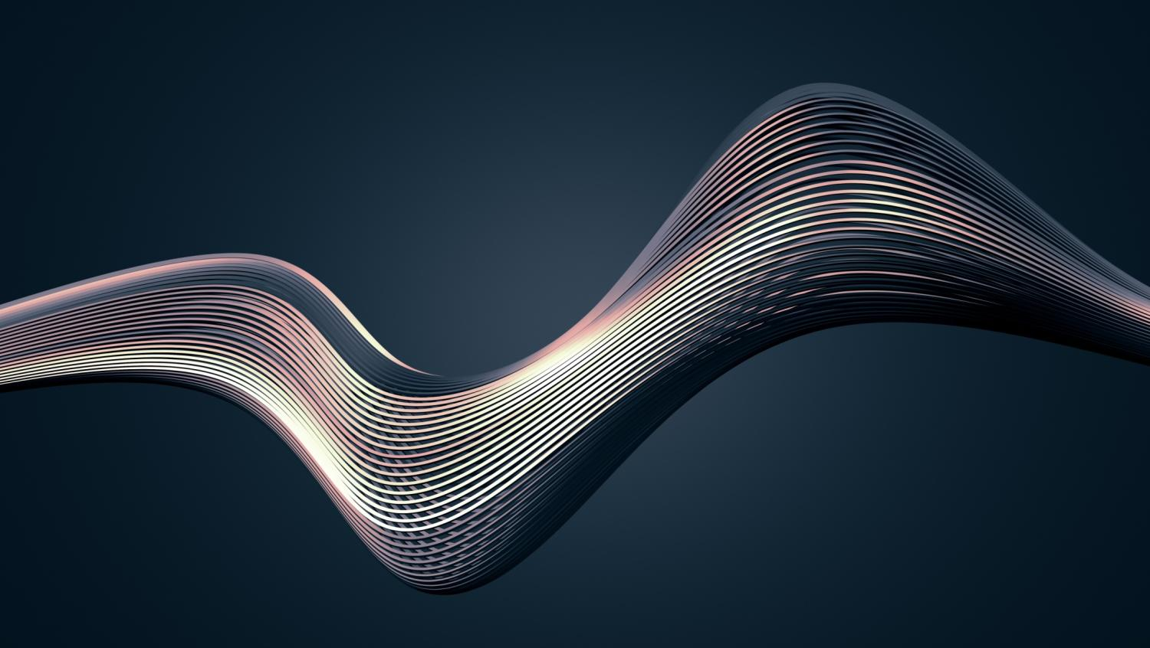
Relia® Improved cold formability
© VAlex /Shutterstock.com

Slide 5
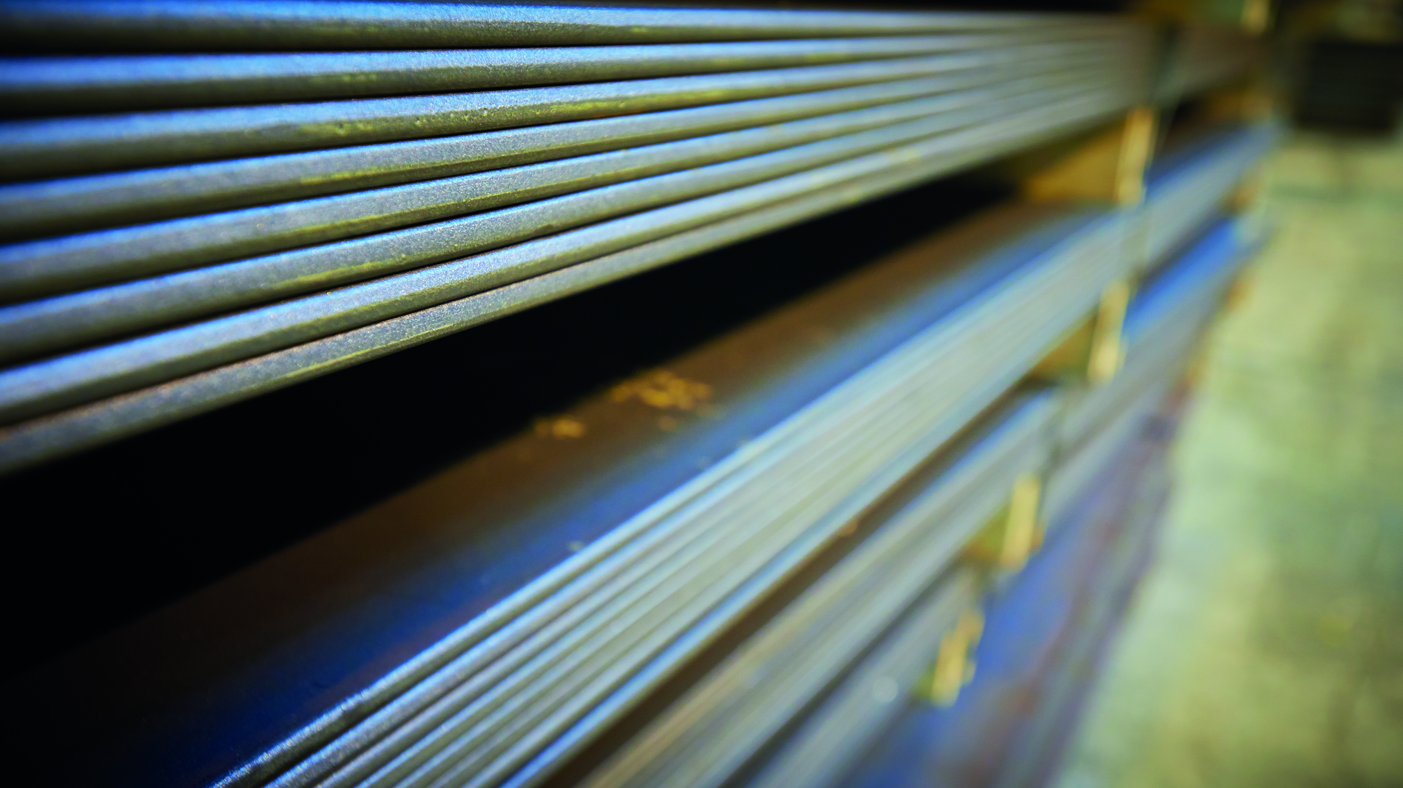
© Industeel
Relia® Excellent flatness

Slide 6
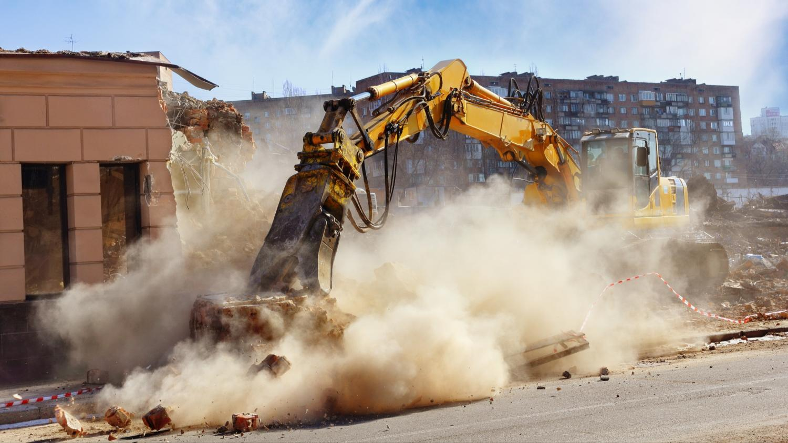
© Verhovinets Taras/Shutterstock.com
Relia® Tougher & longer lasting even in extreme environments

Slide 7
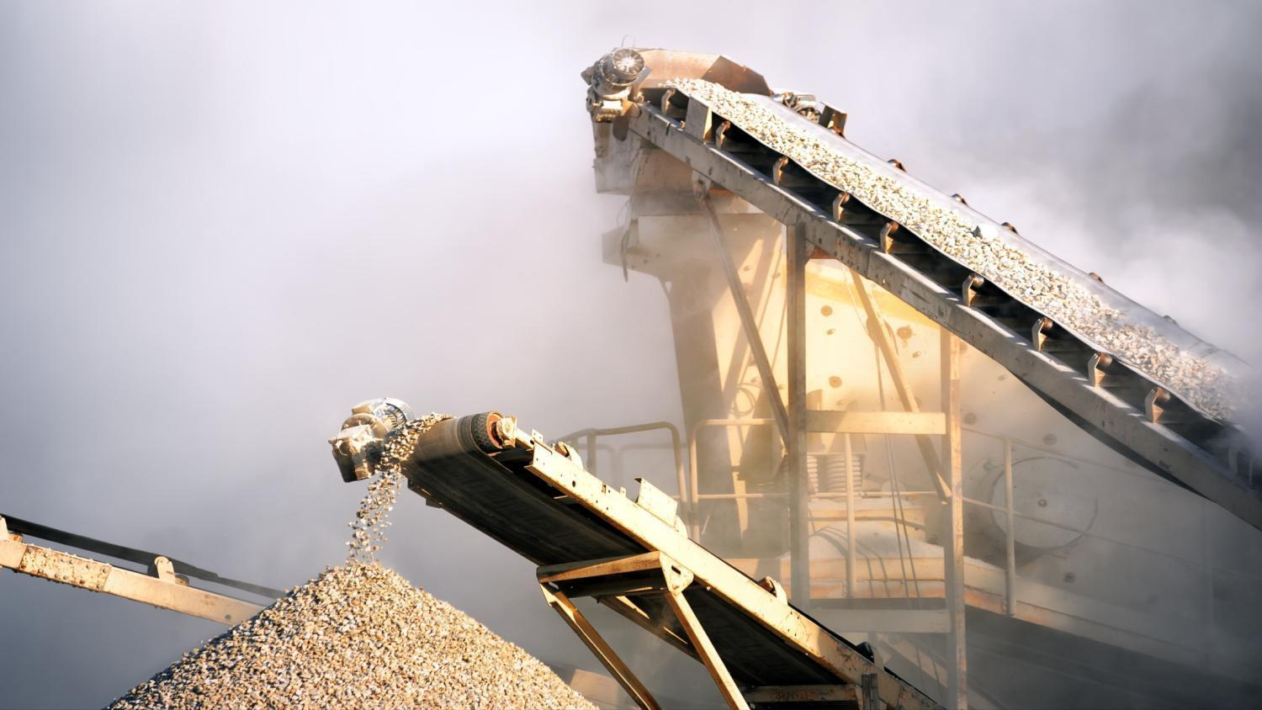
Relia® Optimal operational performance with minimum downtime
© Banana Republic images/Shutterstock.com

Slide 8
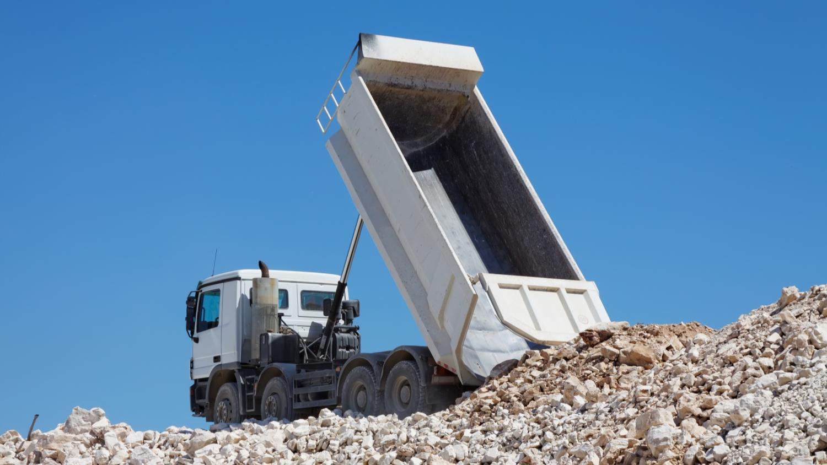
Relia® Improve your efficiency
© burnel1/Shutterstock.com

Slide 9
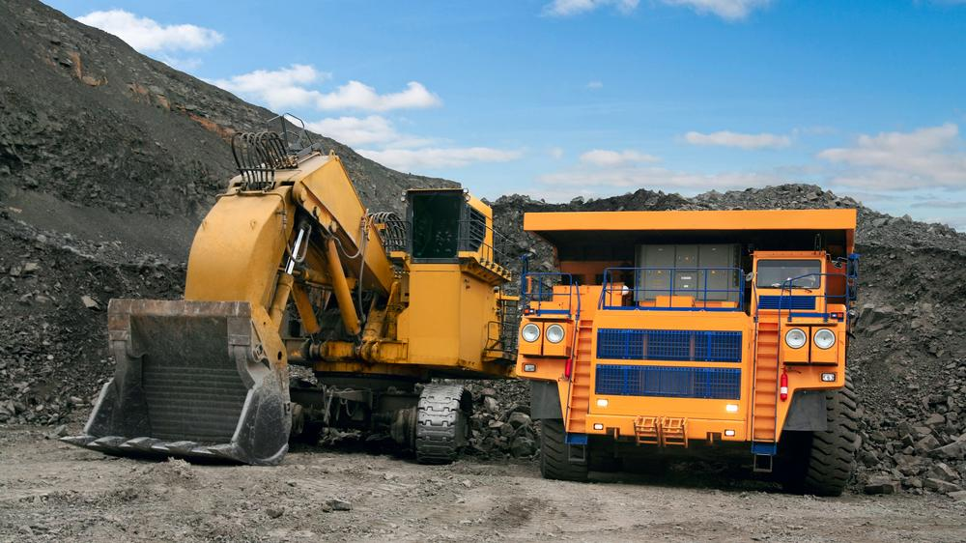
Relia® Wide range of dimensions and tight manufacturing tolerances
© MiloVad/Shutterstock.com

Slide 10
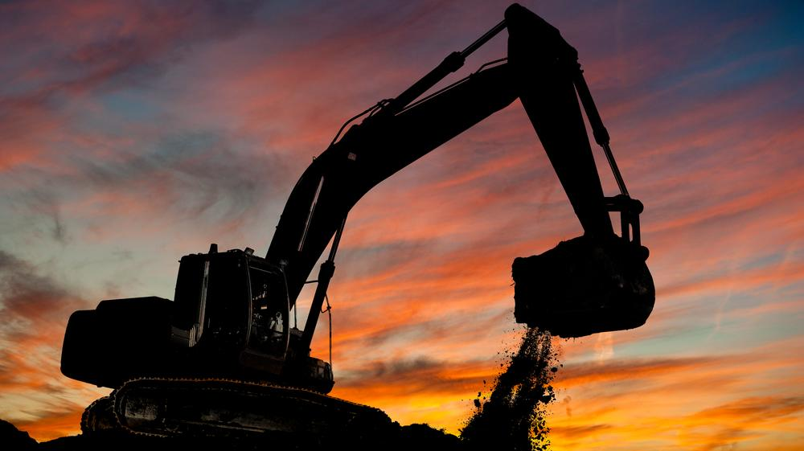
Relia® Extended service life
© Dmitry Kalinovsky/Shutterstock.com

Slide 11
Relia® Excellent welding characteristics
© Biletskey/Shutterstock.com

Slide 12
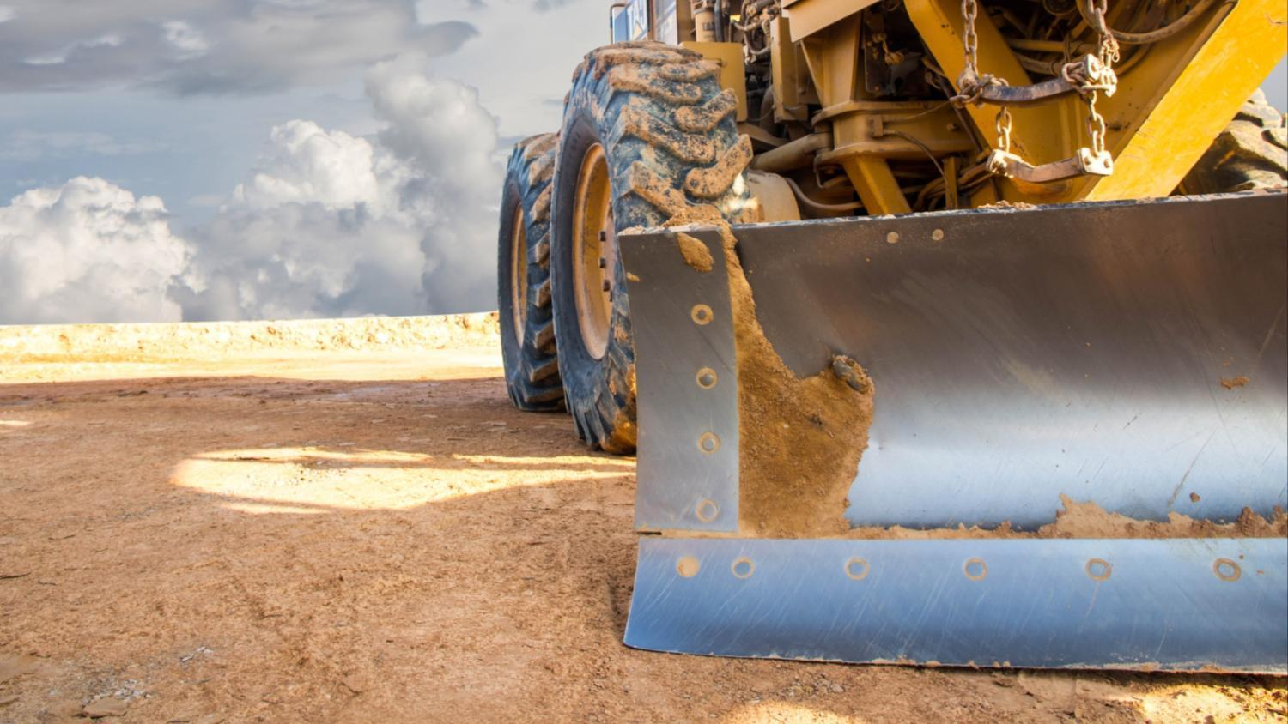
Relia® Excellent toughness
© Yuttana jeenamool/Shutterstock.com

Slide 13
© Four Oaks, shutterstock.com, adapted by Philippe Vandenameele
Relia® Minimum wear, maximum payload

Slide 14
Produced by: ArcelorMittal Europe Communications
© 2016

