Slide 1


Magnelis®
Think Strategy
© Movemedias

Slide 2

Magnelis®
has a protective coating offering
an improved corrosion resistance thanks to 3% magnesium
in the metallic layer.
© Jeroen op de Beeck

Slide 3
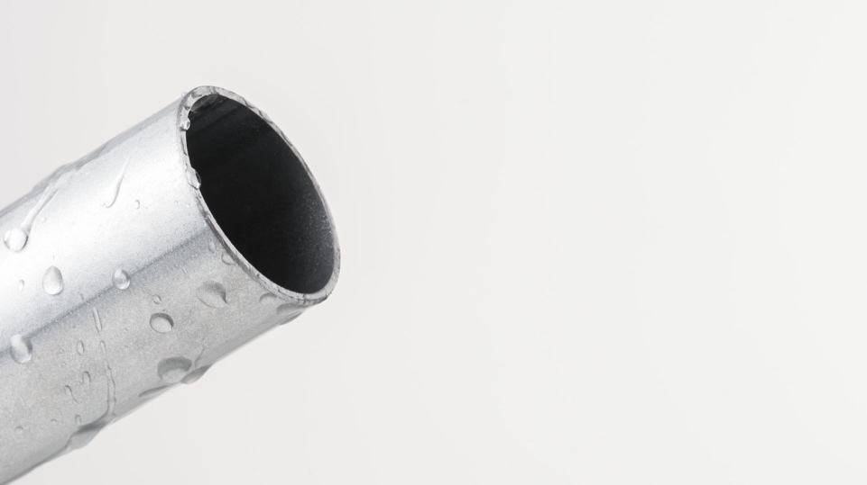
Magnelis®
has three times better
corrosion resistance
than galvanised steel.
© Jeroen op de Beeck

Slide 4
Magnelis®
demonstrates the best corrosion resistance
in harsh environments.
© Shutterstock – Robsonphoto,

Slide 5
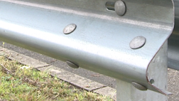
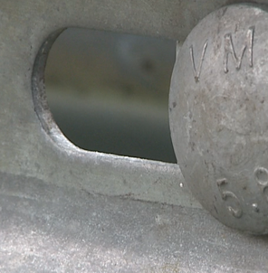
Magnelis®
provides
a self-healing effect
for edge protection.
© Grupo Condesa

Slide 6
Magnelis®
offers deformed or scratched surfaces
extra protection.
© Jeroen op de Beeck

Slide 7
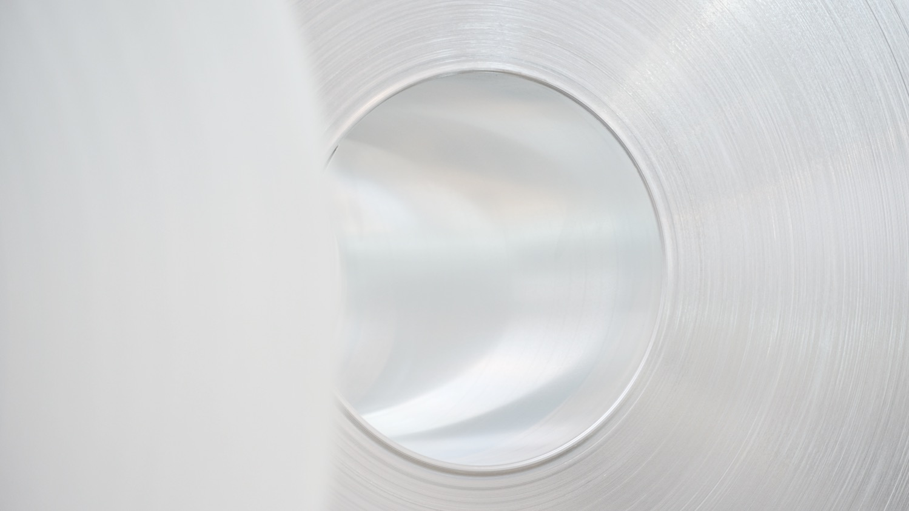
  Magnelis®
  is a cost-effective alternative
  to post-galvanised steels.
© Jeroen op de Beeck

Slide 8
Magnelis®
is available in a wide range
of steel grades with a metallic coating layer up to 35 µm.
© Jeroen op de Beeck

Slide 9
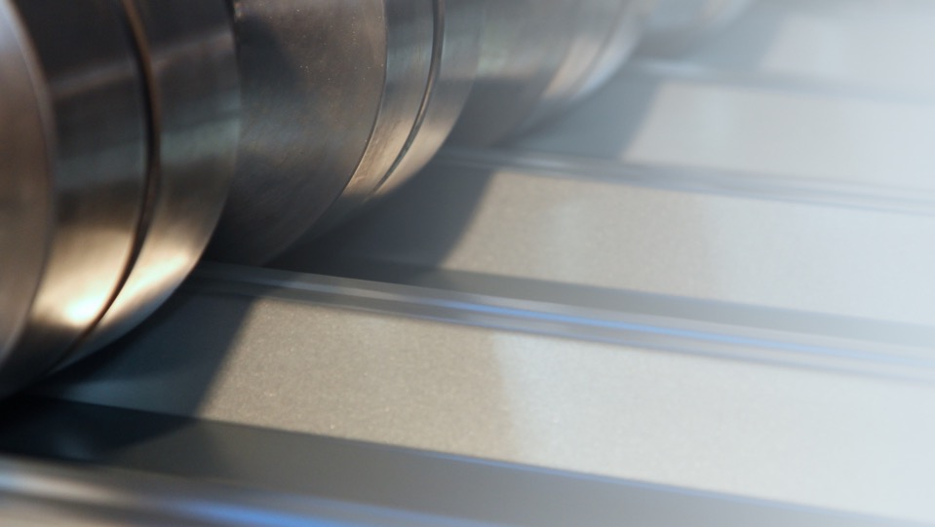
Magnelis®
is easy to process.
© Kurp Dach

Slide 10
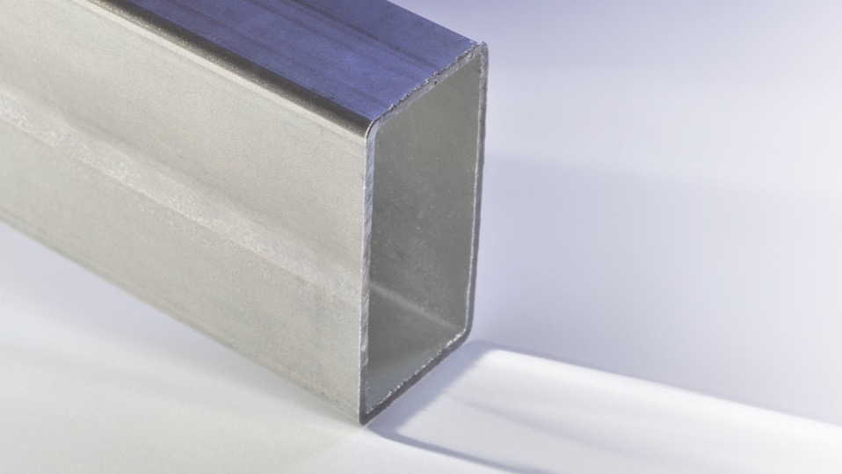
Magnelis®
provides a higher level
of protection on welded areas and outperforms pre-coated welded tubes.
© Jeroen op de Beeck

Slide 11
Magnelis®
is included in European standards and covered
by certifications.
© © Shutterstock – feiyuezhangjie

Slide 12
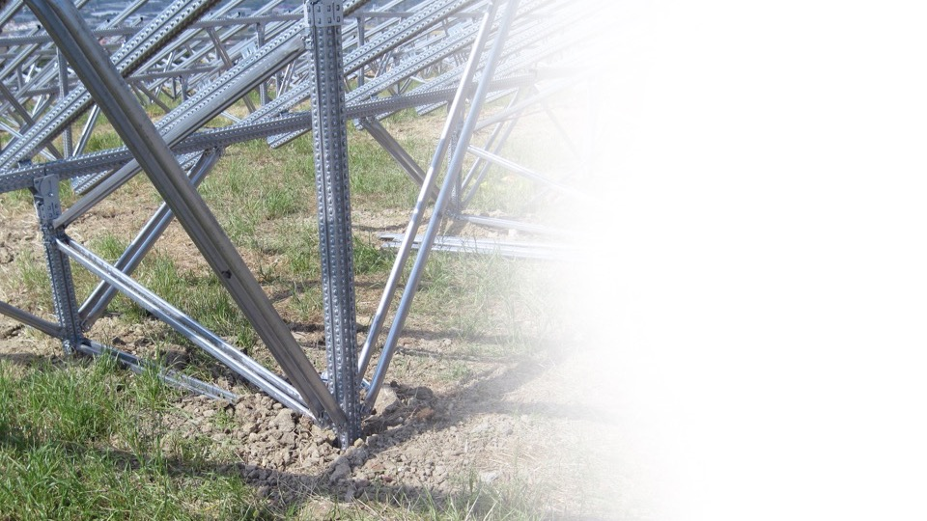
Magnelis®
has a superior behaviour in soils.
© Metalsistem

Slide 13
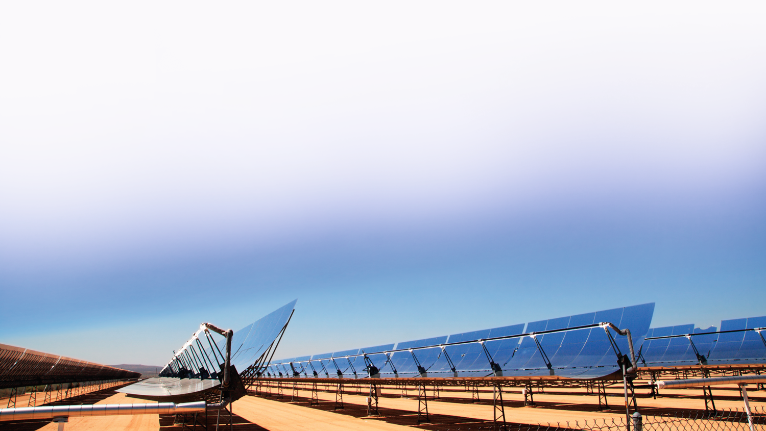
Magnelis®
is the preferred coating
for solar structures.
© Shutterstock – Tom Grundy

Slide 14
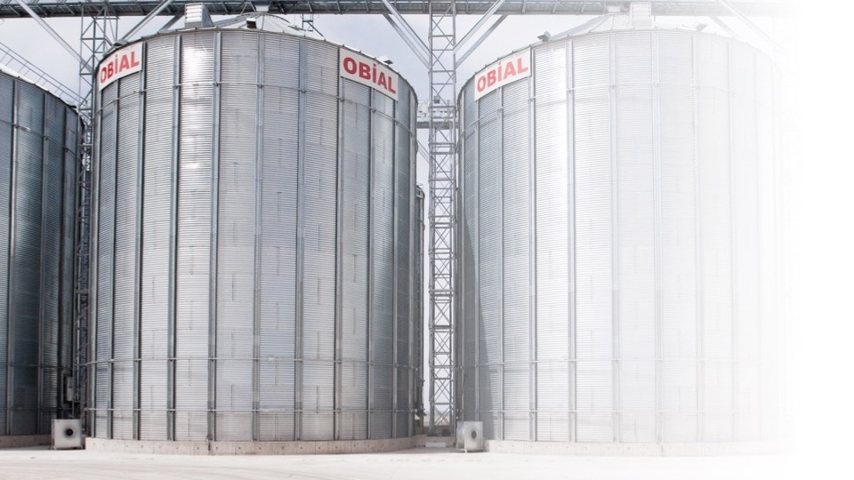
Magnelis®
offers optimal protection
for agricultural applications.
© Oblian

Slide 15
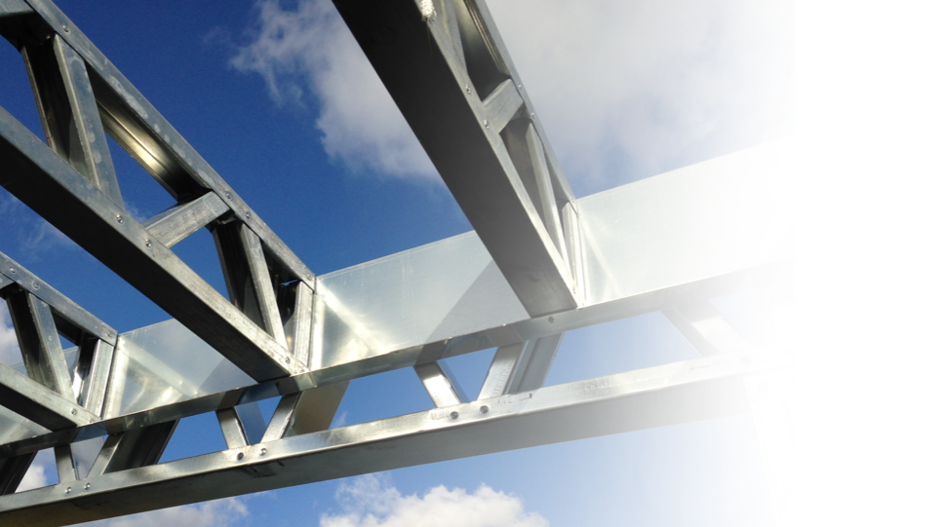
Magnelis®
protects the structures
of the building…
© beSteel

Slide 16

… and ensures
corrosion resistance while maintaining the electrical conductivity of cable trays.
© Shutterstock – maxuser

Slide 17
Magnelis®
Think Strategy
© Movemedias
Produced by ArcelorMittal Europe – Commercial Communications © 2016

